Slide 1


SER 502 : Languages and Programming Paradigms Compiler and Runtime Construction for
Group 23
Devanshi Panu
Abhinav Mishra
Sunil C Gowdru

Slide 2
Description
Bru is easy to use programming language for any beginner in programming
Aimed at implementing with minimal effort and time
Implements powerful features of Recursion, Stack, Symbol table, Activation Record
Showcase complex constructs in programming language Nested Loops, Nested Conditional

Slide 3
Tools used
Parser / Lexer
ANTLR 4.5 (Another Tool for Language Recognition)
- Translates your grammar to a parser / lexer in Java (or other target language)
Intermediate Code
Intermediate bytecode with .bruclass file extension, intermediate code is generated using Java
Runtime Engine
Java Code for runtime translates intermediate code into required output

Slide 4
Antlr Grammar Snippet
grammar LabeledExpr; prog: (stat|function)+ ; stat: expr NEWLINE* # printExpr | ID '=' expr NEWLINE* # assign | looping #loops | condition #ifcond | NEWLINE #blank | 'stack' ID NEWLINE #stackdec ; expr: expr'++' #postfix | expr op=('*'|'/'|'%') expr #MulDivMod | expr op=('+'|'-') expr #AddSub | expr op=('<'|'>'|'<='|'>=') expr #relational | expr op=('=='|'!=') expr #equality | expr op=('&&' | '||') expr #logicalANDOR | INT #int | BOOL #bool | STRING #string | ID #id | '(' expr ')' #parens | ID '(' args=arguments ')' #funccall | ID '.' 'pushstk' '(' INT ')' #stkpush | ID '.' 'popstk' '()' #stkpop | ID '.' 'peekstk' '()' #stkpeek | ID '.' 'emptystk' '()' #stkempty ;

Slide 5
Antlr Parsing / Lexing
ANTLR generates a parse-tree Visitor interface that visits each nodes of parse tree using tree walker
In Visitors method, a ParseTree Base Visitor interface is generated based on grammar written in ANTLR
We then override these methods to generate our intermediate code as per our needs
We are writing this intermediate code to file with .bruclass extension

Slide 6
Grammar Features
Our grammar supports data types like boolean and integer.
Data structures supported include stacks.
Control constructs like “if-else” and looping constructs like “while” are provided
Can handle math operators like +, -, *, /, %
Handles relational operators like <, <=, >, >=, ==, !=

Slide 7
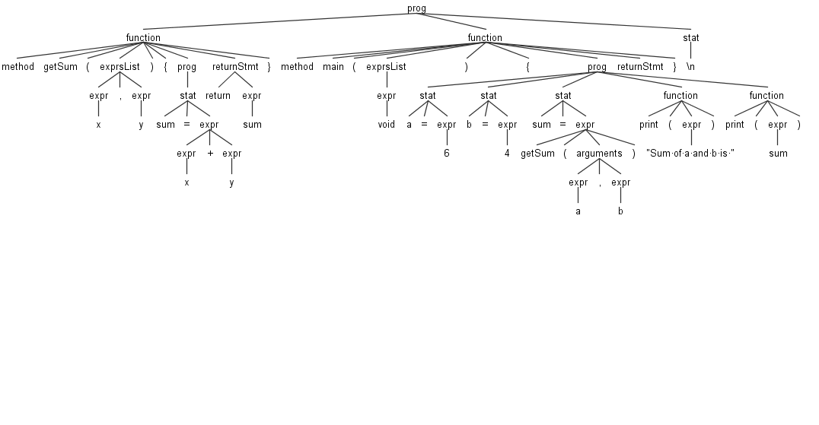
Parse Tree

Slide 8
Steps for Execution (Compilation / Runtime)
Open cmd and goto the folder location containing programs with Script files
Execute to compile on windows
bruc <filename with .bru extension>
generates .bruclass file
Execute to run on windows
bru <filename with .bruclass extenstion>

Slide 9
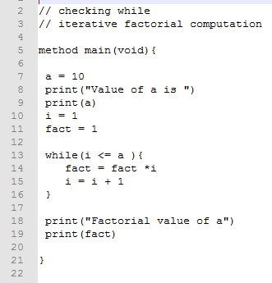
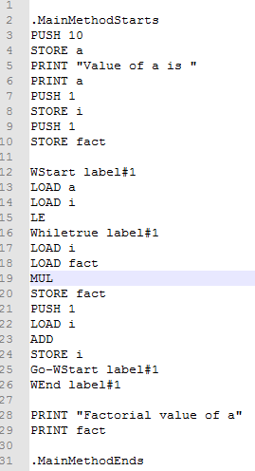
Intermediate Bytecode

Slide 10
Runtime - Features
Dynamically typed
-Value type is determined at runtime depending on value of variable
Bru Runtime is based on JVM
Runtime uses a stack model.

Slide 11
Runtime - Implementation
Internally uses stacks and hash maps to maintain the environment, symbol table and activation records
While running any program if the second argument is given as “-sym” then it outputs the symbol table at each step.
During execution, every function call is recorded and maintained on a instruction stack.

Slide 12
Links
YouTube Video Link
https://youtu.be/ftAop4s9mVo
GitHub Link
https://github.com/dpanu/Bru

Slide 13
THANK YOU
Keep “Bru”ing

